Slide 1
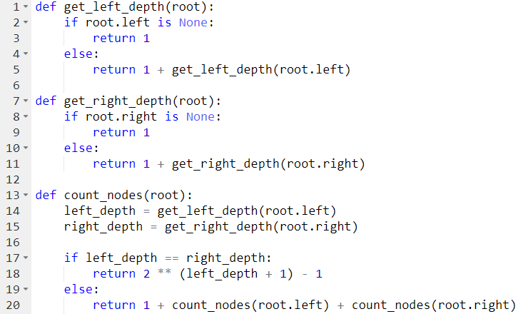
Sample Improved Algorithm

Slide 3
log(n)_{left} + log(n)_{right} = 2log(n)

Slide 4
2log(n) + 4log(n)

Slide 5
But this side is now done!
2log(n) + 4log(n)

Slide 6
But this side is now done!
2log(n) + 4log(n) + 4log(n)

Slide 7
But this side is now done!
This side is now done!
2log(n) + 4log(n) + 4log(n)

Slide 8
But this side is now done!
This side is now done!
2log(n) + 4log(n) + 4log(n) + 4log(n)

Slide 9
But this side is now done!
This side is now done!
All Done!
2log(n) + 4log(n) + 4log(n) + 4log(n)

Slide 10
But this side is now done!
This side is now done!
All Done!
2log(n) + 4log(n) + 4log(n) + 4log(n)
There are a maximum of 4 depth check per level. Each depth check is log(n).
T(n) ~ 4 * depth * log(n) = 4 * log(n) * log(n)
O( [log(n)]² )

